Slide 1

Spring Boot CRUD Application: A Deep Dive
This presentation explores a Spring Boot CRUD app using PostgreSQL and JPA. The application demonstrates Create, Read, Update, Delete operations with REST APIs. Code is hosted on GitHub for full access.
gk
by girish kudachi

Slide 2
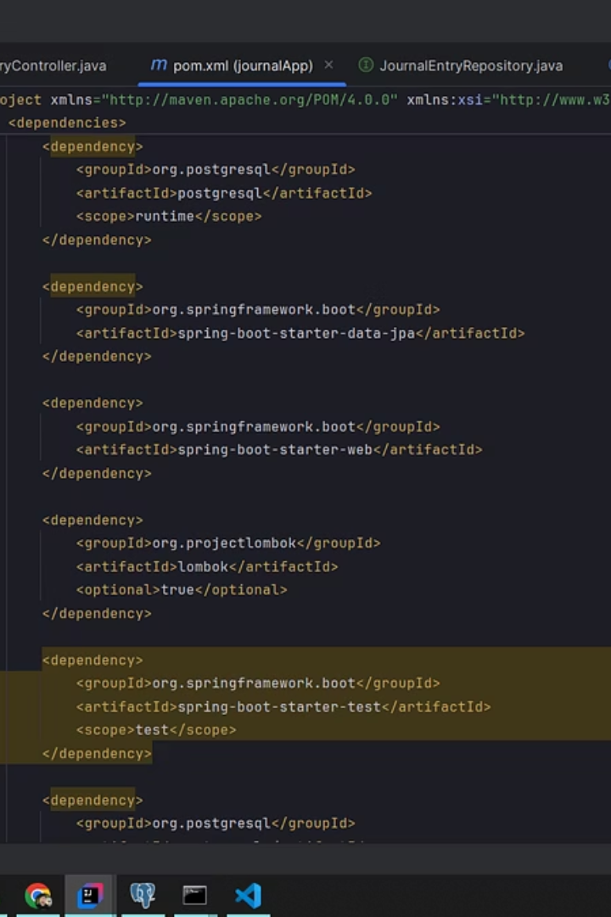
Project Setup and Dependencies
Development Environment
Using IntelliJ IDEA for efficient Java and Spring Boot coding.
Core Dependencies
spring-boot-starter-data-jpa for JPA integration
postgresql driver for database connection
lombok for automatic code generation
spring-boot-starter-web for REST API functions
spring-boot-devtools for hot reload

Slide 3
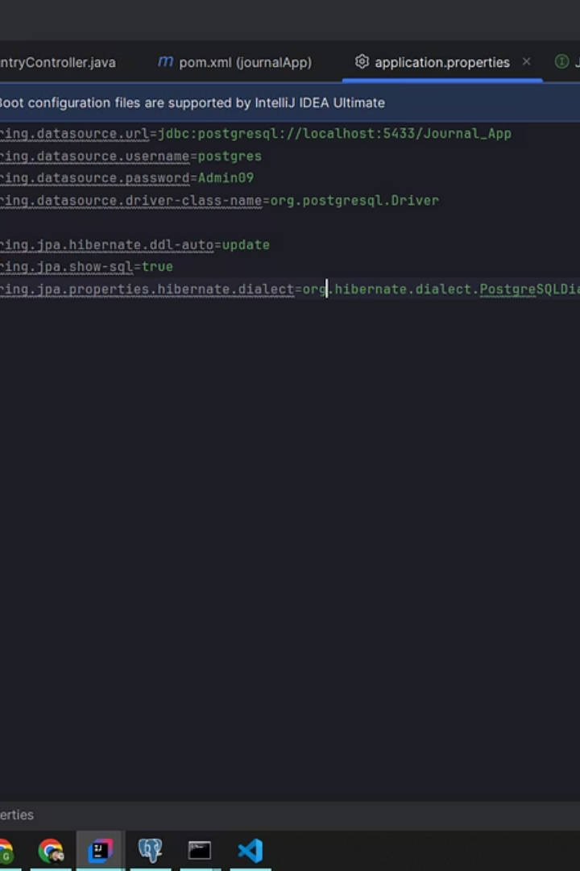


Database Configuration with PostgreSQL
Database Setup
Key Configuration
Configured PostgreSQL locally and optionally cloud-based instances.
Datasource URL, username, password set in properties file.
Schema Management
Used spring.jpa.hibernate.ddl-auto for automatic schema updates.

Slide 4
Entity Definition with JPA
Entity Setup
Annotations
Defined entities with @Entity and mapped to database tables.
@Id and @GeneratedValue for primary keys
@Column for column mappings
Example: User entity involves id, name, email fields.
Lombok @Data and constructors for boilerplate code

Slide 5
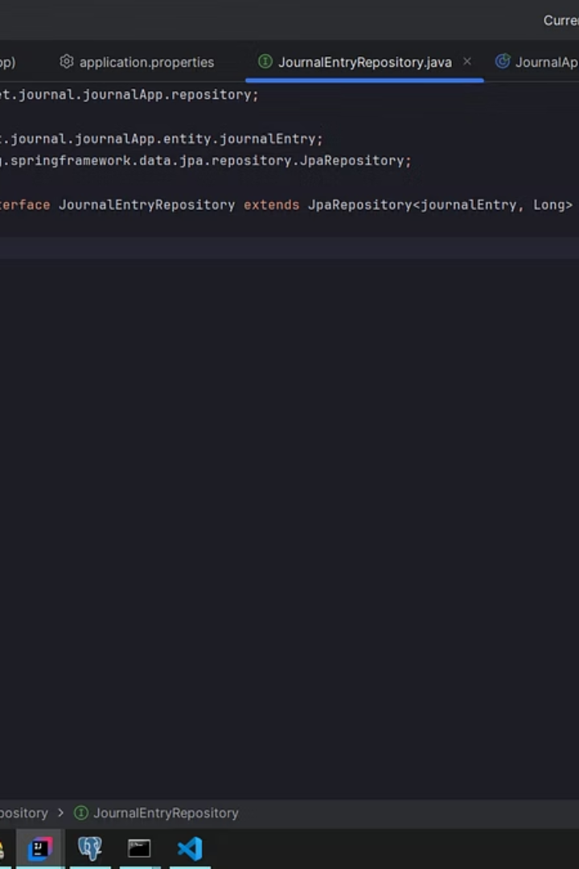
Repository Layer with Spring Data JPA
Repository Interface
Built-in Methods
Extended JpaRepository to enable CRUD without extra code.
save(), findById(), findAll(), deleteById()
Custom Queries
Derived query methods by method naming like findByEmail().

Slide 6
Service Layer Implementation
Business Logic
Transaction Management
Services handle data manipulation and business rules.
@Transactional ensures data integrity during operations.
Example methods: createUser, getUserById, updateUser, deleteUser.

Slide 7
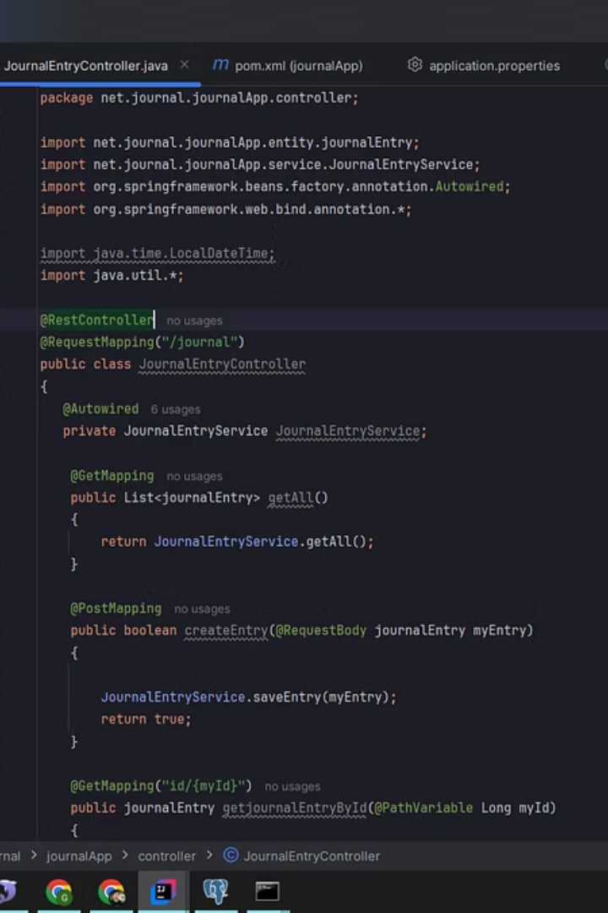



REST API Controller Design
Controller Annotations
@RestController and @RequestMapping organize API endpoints.
HTTP Methods
@PostMapping for create
@GetMapping for read
@PutMapping for update
@DeleteMapping for delete
Parameter Binding
@PathVariable and @RequestBody simplify data handling.

Slide 8
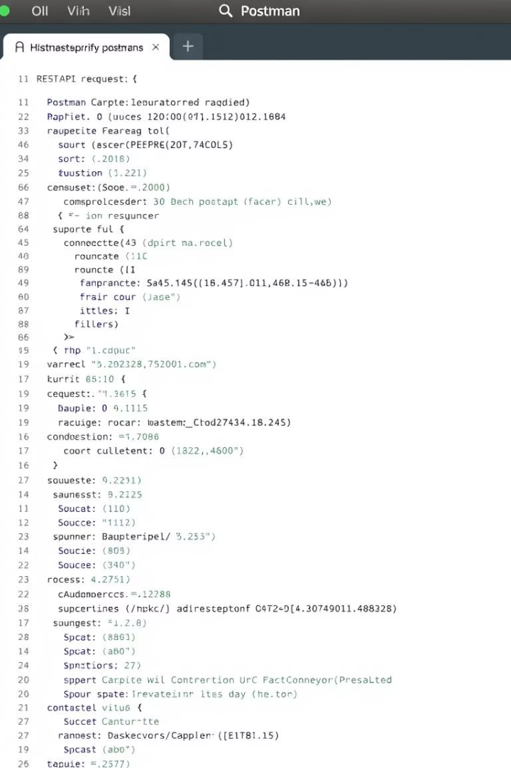
Testing the APIs with Postman
1
Create User
2
Retrieve User
Sent POST request with JSON payload to /api/users.
Tested GET endpoint using user ID parameter.
3
Update and Delete
Confirmed PUT and DELETE operations via API calls.

Slide 9
Code Structure and Best Practices
Project Layout
Standards
src/main/java structured by layers
Consistent naming and error handling improve maintainability.
resources hold config files

Slide 10

Conclusion and Future Enhancements
Summary
Next Steps
CRUD app leverages Spring Boot with PostgreSQL efficiently.
Add pagination and sorting support
Implement request validation
Enable authentication and authorization
Deploy to cloud platforms like AWS or Heroku
Discussion
Open floor for questions and future collaboration ideas.

